Slide 1
LIF 111
Application of Recombinant DNA Technology: Molecular detection and DNA finger printing
Tuesday, 31 January 2022
Complementary base pairing allow DNA denaturation and renaturation www.youtube.com/watch?v=0qoqzErrae4

Slide 2
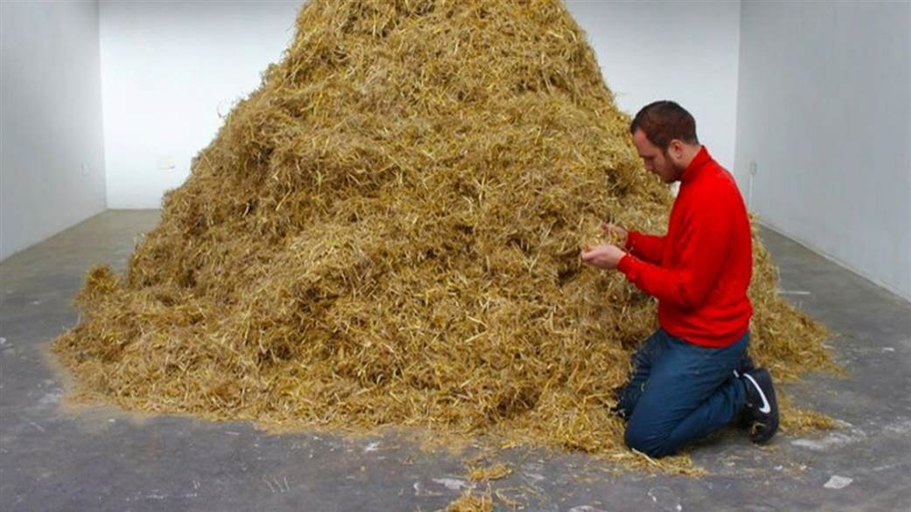
When we search for say a 10,000 bp long DNA/gene in the 3.0 ×10⁹ bp long human genome, we are essentially searching a needle from a haystack
Looking for a needle in a haystack!
Southern blot:
How to identify a desired piece of DNA from the total genome

Slide 3
Background information # 1
REs with 6-nucleotide recognition sites (6-cutters) are widely used in molecular biology
Sites would randomly be expected every 1/4096 nucleotides (1/4⁶)
Actual sizes vary widely with average of ~4000 bp
Recognition sites are often palindromes
Restriction Enzyme Recognition site
EcoRI G A A T T C
Hind III A A G C T T
BamHI G G A T C C

Slide 4
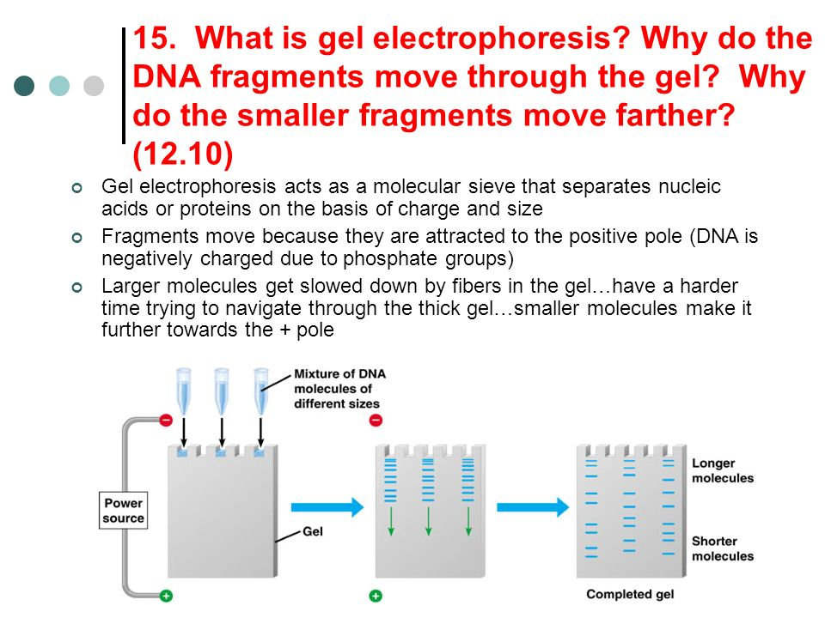
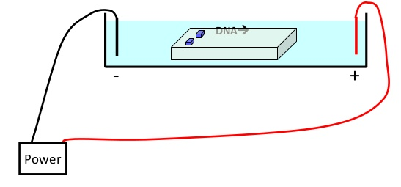
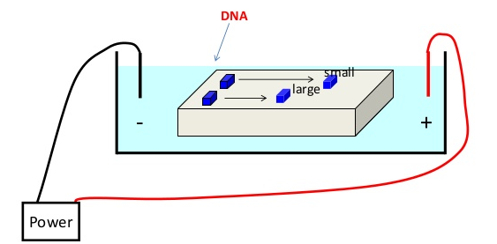
Background information # 2
Gel electrophoresis: a technique to separate DNA by size
DNA is negatively charged due to its sugar-phosphate backbone
Thus, when placed in an electrical field, DNA migrate towards the positive pole
Agarose gel is used to slow the movement of the DNA and separate by size
0 hr
1 hr later

Slide 5
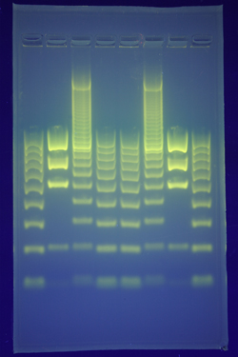
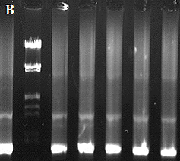
Background information # 2 contd
Restriction digested genomic DNA. It appears as a smear since the fragment of all sizes are present here
Molecular weight
marker DNA fragment
Restriction digested fragments of genomic DNA from an eukaryote
How do we then search out a DNA fragment of our interest from this restriction digested fragment?
Restriction digested fragments of DNA vector

Slide 6
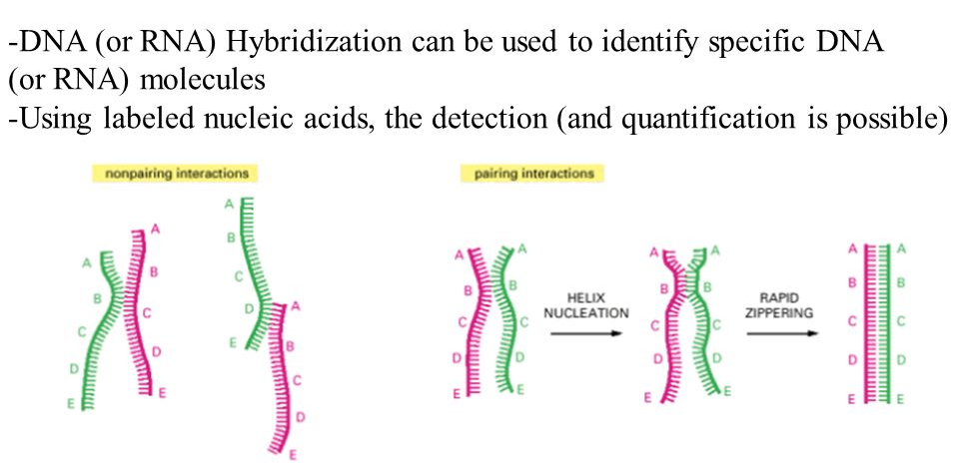
Background information # 3
Single stranded DNAs can hybridize with complementary sequences
Non-pairing interactions
Pairing interactions

Slide 7
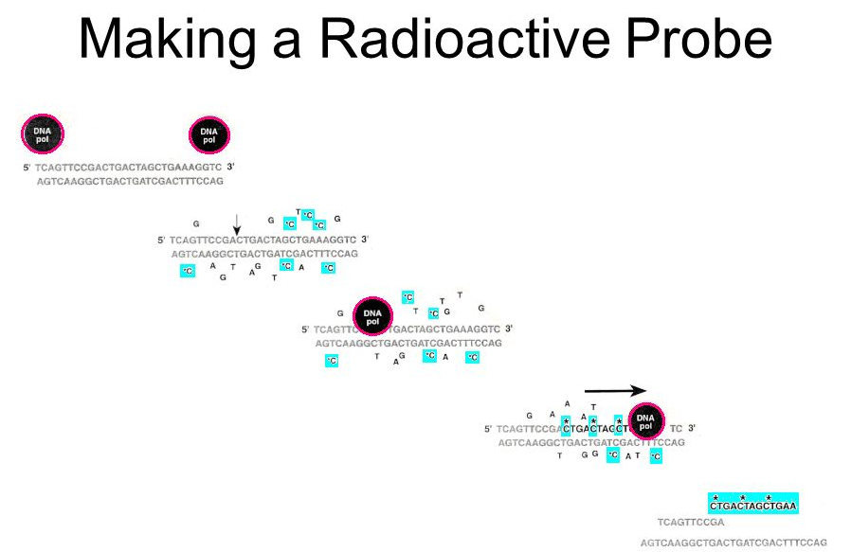
Background information # 3

Slide 8
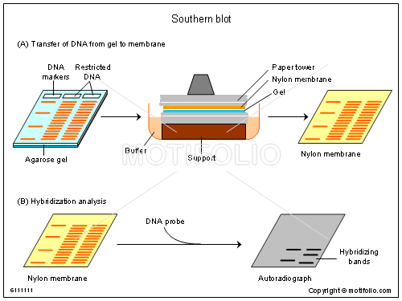
Steps in Southern blot
This DNA probe (e.g., cloned fragment of globin gene) is labeled (radioactively)
https://www.youtube.com/watch?v=GPVf_AWMYZ4

Slide 9
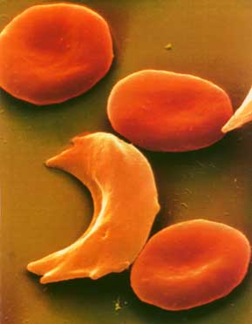
Example Point Mutation
Recap
Sickle Cell disease is the result of one nucleotide substitution
Occurs in the hemoglobin gene
The sixth position in the normal beta chain has glutamic acid, while sickle beta chain has valine. This is the sole difference between the Hb^{S} an allele of Hb^{β}

Slide 10
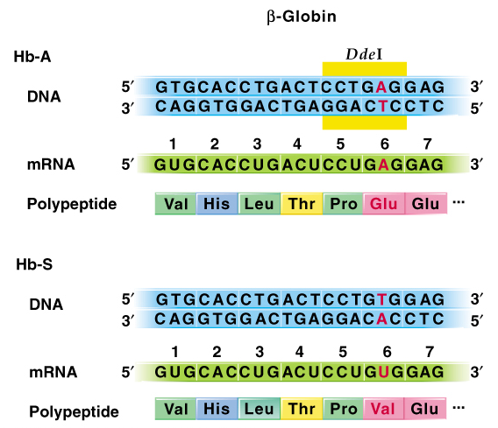
β-globin gene, mRNA, and polypeptide showing the normal Hb-A sequences and the mutant Hb-S sequences
DdeI is a restriction enzyme that recognizes a sequence 5’ CTNAG 3’ (where N stands for any nucleotide)
This mutant sequence cannot be recognized by DdeI

Slide 11
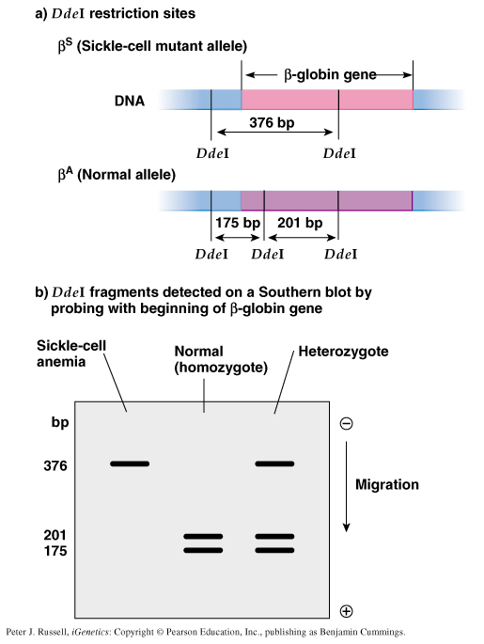

Detection of sickle-cell gene by the DdeI restriction fragment length polymorphism in southern blot
This is detection of the restricted fragments of the Hb gene by radioactive probe by southern blot.
What does this band represent? Why it is absent in normal individuals and why it is present as a single band sickle cell individuals

Slide 12
Examples of DNA Molecular Testing
Sickle-cell anemia is an example:
  a. A single base-pair change in the b-globin gene results in abnormal hemoglobin, Hb-S, rather than the normal Hb-a. Hb-S molecules cause sickling of red blood cells.
  b. The Hb-S mutation is an AT-to-TA base pair change in the 6th codon of b-globin, resulting in a valine rather than a glutamic acid, and also eliminating a DdeI restriction enzyme site .

Slide 13
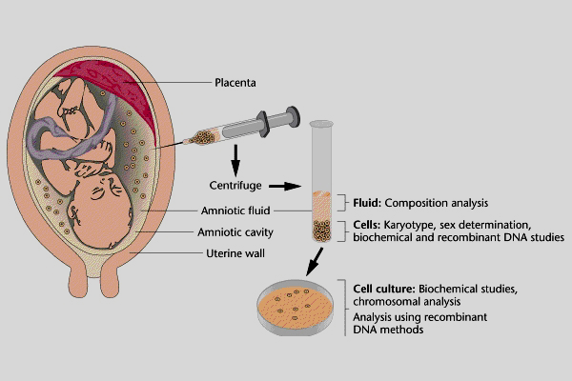
A practical use of Southern blot: genetic testing
  Prenatal diagnosis
  Newborn screening.
  Carrier (heterozygotes) detection
Amniocentesis:
A method to collect fetal cells

Slide 14
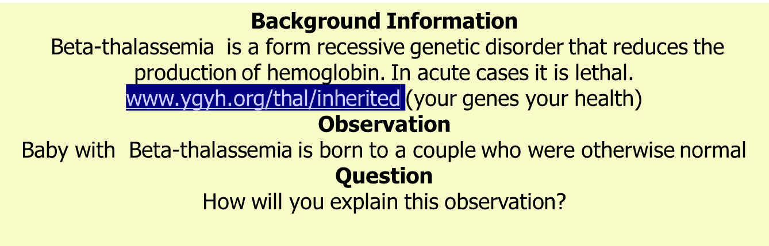
Recap
Answer: Progeny of (T/t X T/t) would thus be: (T/T, T/t and t/t)
Can the birth of the unfortunate thalassemic baby be avoided?
Can the carrier individuals be detected?

Slide 15

Concept of DNA Molecular Testing
1. Designing DNA molecular tests requires knowledge of gene mutations that cause a disease, derived from sequencing the gene involved.
2. Often a disease is caused by a variety of mutations, complicating its study. The breast cancer genes BRCA1 and BRCA2 are examples:
  a. Normal BRCA1 and BRCA2 genes control cell growth in breast and ovarian tissue.
  b. Mutations in the BRCA1 and BRCA2 genes can lead to cancer. Hundreds of mutations in these genes have been identified.
  c. Each BRCA1 or BRCA2 mutation confers a different risk of developing cancer, ruling out a single DNA molecular test to assess an individual’s breast cancer risk associated with these genes.
3. Genetic testing reveals the presence of a mutation associated with a genetic disease.
Why this image makes sense here??

Slide 16
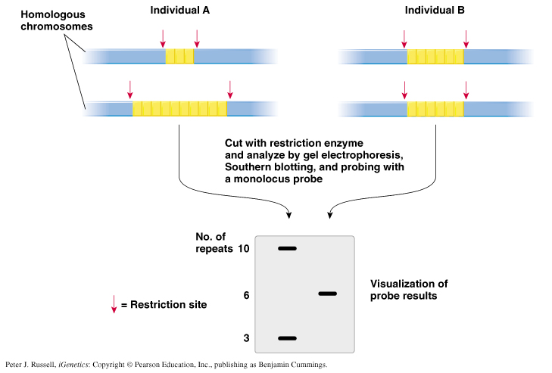
Short tandem repeats (STR) A short tandem repeat is a microsatellite, consisting of a unit of two to thirteen nucleotides repeated hundreds of times in a row on the DNA strand.
DNA finger printing
Since each one of us inherit different combination of maternal and paternal satellite repeats, we are all unique. These Satellite repeats are thus out DNA finger prints
Satellite DNA consists of very large arrays of tandemly repeating, non-coding DNA.

Slide 17
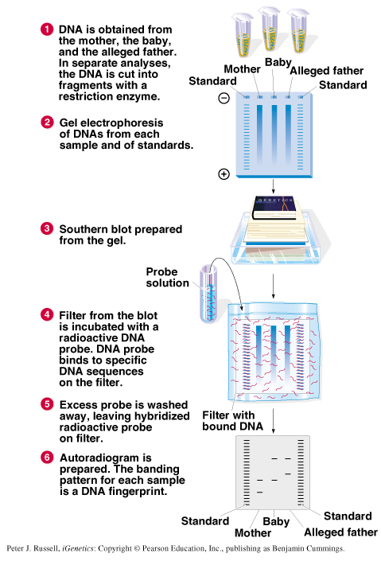
Fig. 8.10 Procedure for DNA typing as used for a paternity case
Is he the real father?

Slide 18
Other Applications of DNA Typing
1. Examples of DNA typing used to analyze present-day samples include:
  a. Forensic analysis in criminal cases. DNA samples from victims and suspects are compared
  b. Population studies to determine variability in groups of people.
  c. Proving horse pedigrees for registration purposes.
  d. Forensic analysis in wildlife crimes, allowing body parts of poached animals to be matched and used as evidence.
  e. Detection of pathogenic E. coli strains in foods
  f. Detection of genetically modified organisms (GMOs) in bulk or processed foods, based on the presence of inserted sequences.

